Slide 1
Gen Ed Updates
2012 to 2024

Slide 2
Model
Core English Comp – 2 (6 s.h.)
ENGL 1549 or ENGL 1550
ENGL 1551 (or equivalent)
Math – 1 (3 s.h.)
Knowledge Domains Arts & Humanities – 2 (6 s.h.)
Natural Sciences – 2 (7 s.h.)
Social and Behavioral Sciences – 2 (6 s.h.)
Oral Communication (see "General Education Electives")
General Education Electives
Electives – 3 (9 s.h.)
Oral Communication – recommended elective (required elective for some programs)
Total Hours: 37 s.h.

Slide 3
Policies (Academic Senate; Feb 2024)
Timelines
For Undergraduate Online programs marketed with AP Spring of 2025
All new students Fall of 2025
Continuing students will have option old GER or new GER

Slide 4
Policies (Academic Senate; Feb 2024)
Course Selection
All 3 credit hours (with exception of ENGL 1549, NS lab and Math*)
All current courses shall be required to re-apply to be considered for classification in the new program – No courses will be grandfathered into the program. This sequence for re-application to be defined by the committee.
Courses are traditional face to face (15-week sessions for Fall and Spring) or online (7- week sessions) – note summer will follow summer schedules
Courses shall only be LE courses for HEI classification (with the only exception being the science lab courses)
Initially, there shall be a maximum of 75 courses in the General Education portfolio
Courses can be added only if the maximum number has not been reached
New courses can be added if former courses are removed

Slide 5
Policies (Academic Senate; Feb 2024)
Course Selection (con’t)
Courses must have a minimum enrollment set to 40 students (Composition, Speech Performance, others may have lower minimums)
Courses shall be introductory level (lower division courses) with no prerequisites
Exceptions may be in Composition and Math
Courses must have a clear assessment plan
Including frequency of offering, enrollment review and DFW rates
Courses must indicate a multi-disciplinary approach to achievement of the microcredential
Courses must indicate alignment with UWLO and Ohio36 criteria
Courses can be counted toward general education and the major but only count once for credit hours

Slide 6
Courses
Committee (8 members of existing committee; willing to work over summer)
Large data set, fine-tuned by IR/IT
Focused on last 4 years (2021-2024)
Two reviewers for each course
Several meetings (course reviewers met to discuss rankings)
Finalized list, then refined based on additional feedback/review

Slide 7
Data
Data warehouse system (Power BI)
IR/IT: Cheri Bibler, Lori Hinebaugh, Angela Rovnak, Ray Knapik
DFW rates for all sections over date range
Average DFW rates for each course per academic year
Number of times each course was offered, by section and academic term
Number of students enrolled in each section by term
Number of times course was taught online versus traditional (on ground)
Average number of times a course is offered in an academic year
Average number of students taking each course per academic year

Slide 8
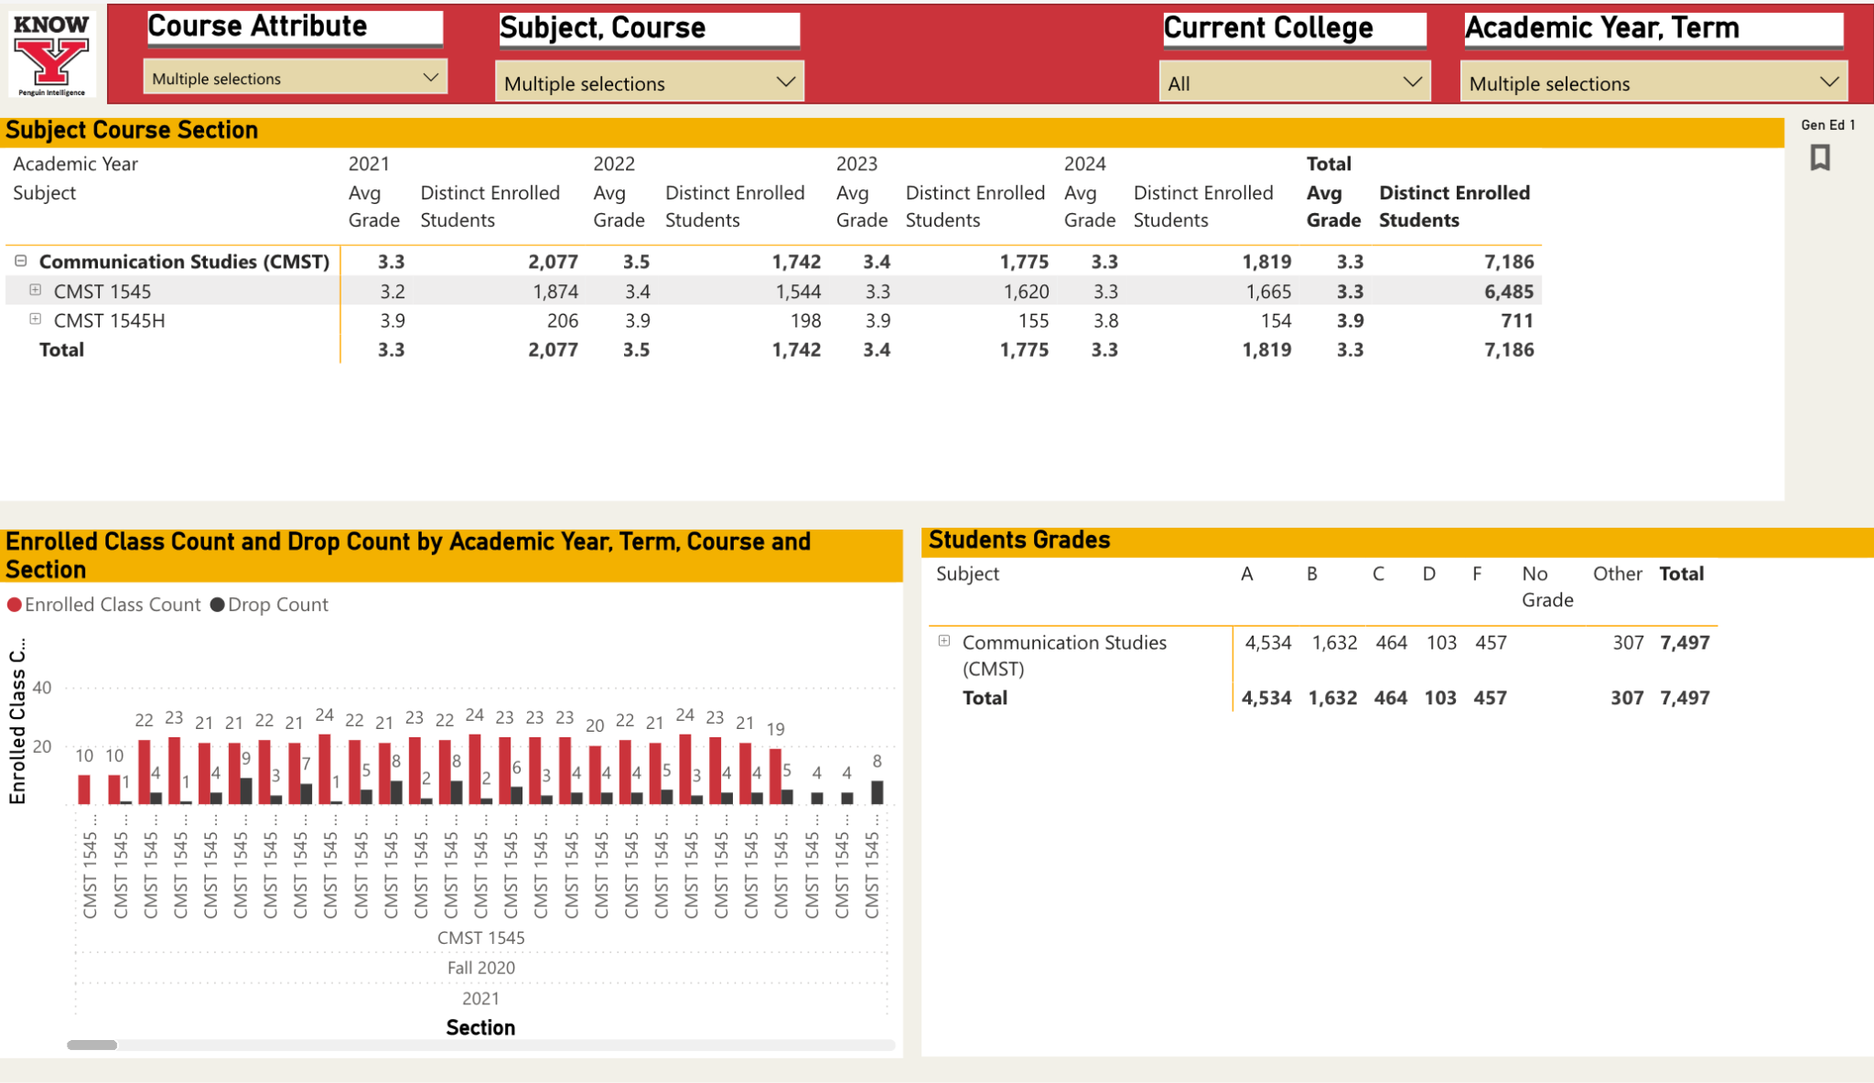

Slide 9
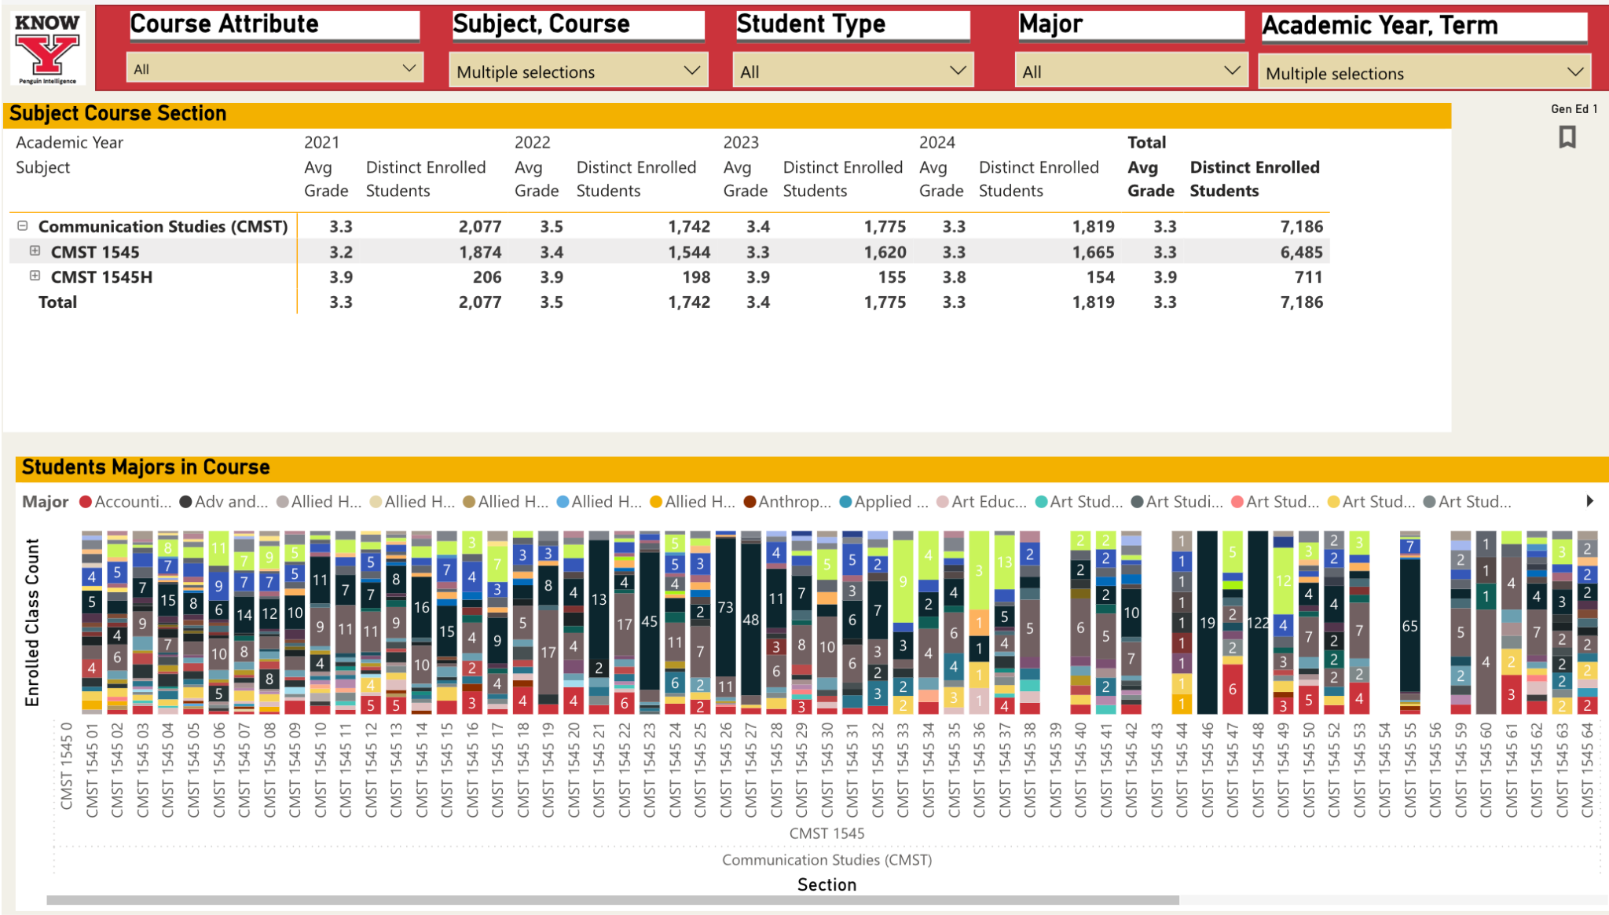

Slide 10
Rubric
Class size (capable of 40+)
Online delivery
Lower division
No pre-req
HEI classification
UWLO alignment
DF rating
Offerings
Enrollment levels
“Other”
Data only got us so far
Judgment calls based on other factors
“discipline-specific” courses
equitability
need course for MCs
in two cases, we went to the Department to ask them to pick the course(s) to cut
Could programs create new gen ed offerings from existing courses?

Slide 11
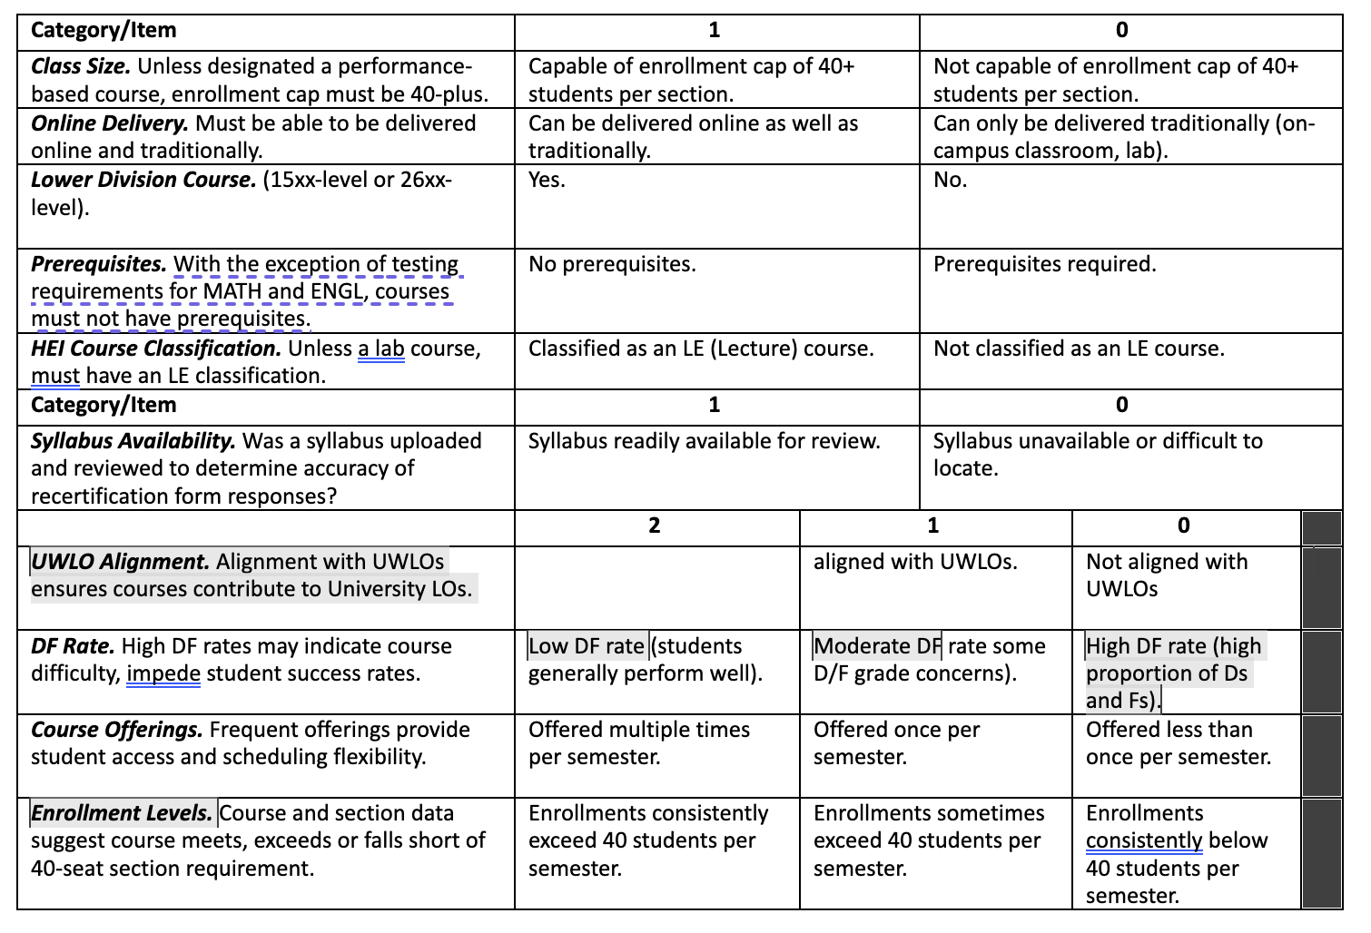

Slide 12
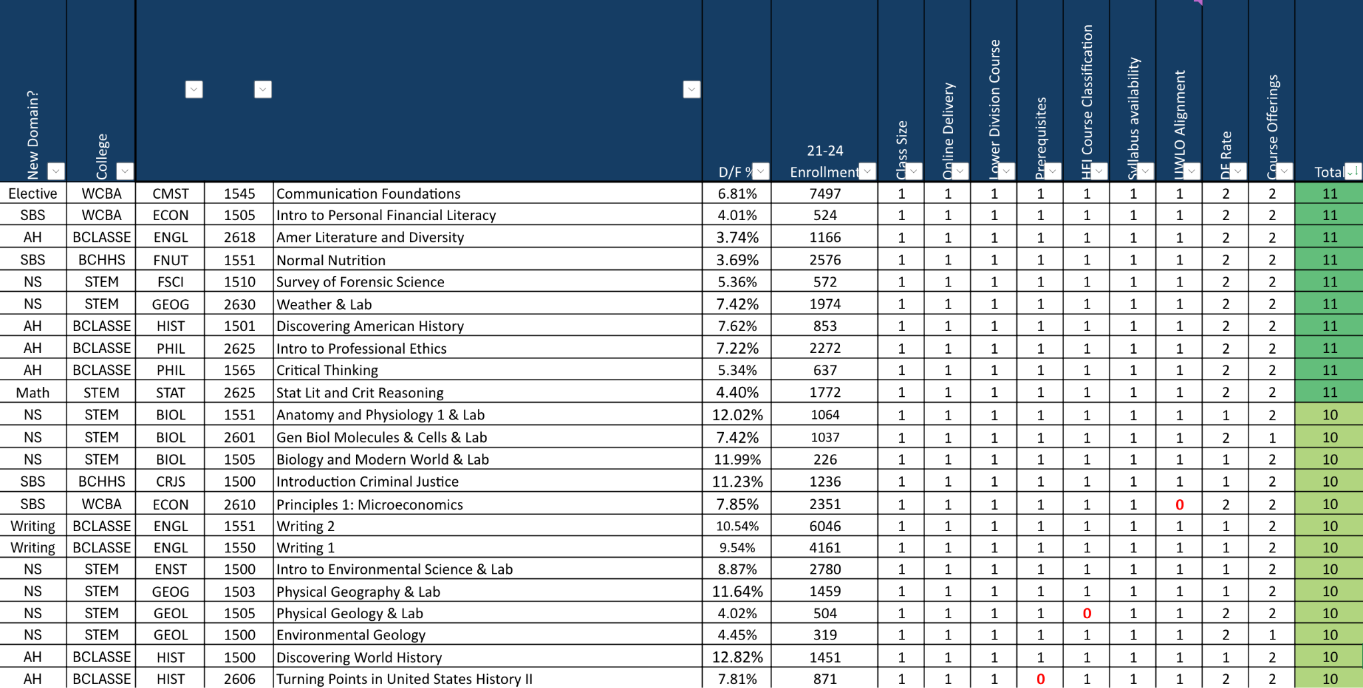

Slide 13
Courses
https://ysu.edu/general-education-program

Slide 14
Microcredentials
327 respondents
Selected based on ratings
Some MCs combined into one
Soft launch, Spring 2025
Needs:
YSU to decide on credentialing solution
Met with multiple vendors
Need before Spring 2025
Courses for 2026-27 MCs
Call for course proposals

Slide 15
Microcredentials
https://ysu.edu/general-education-program/microcredentials

Slide 16
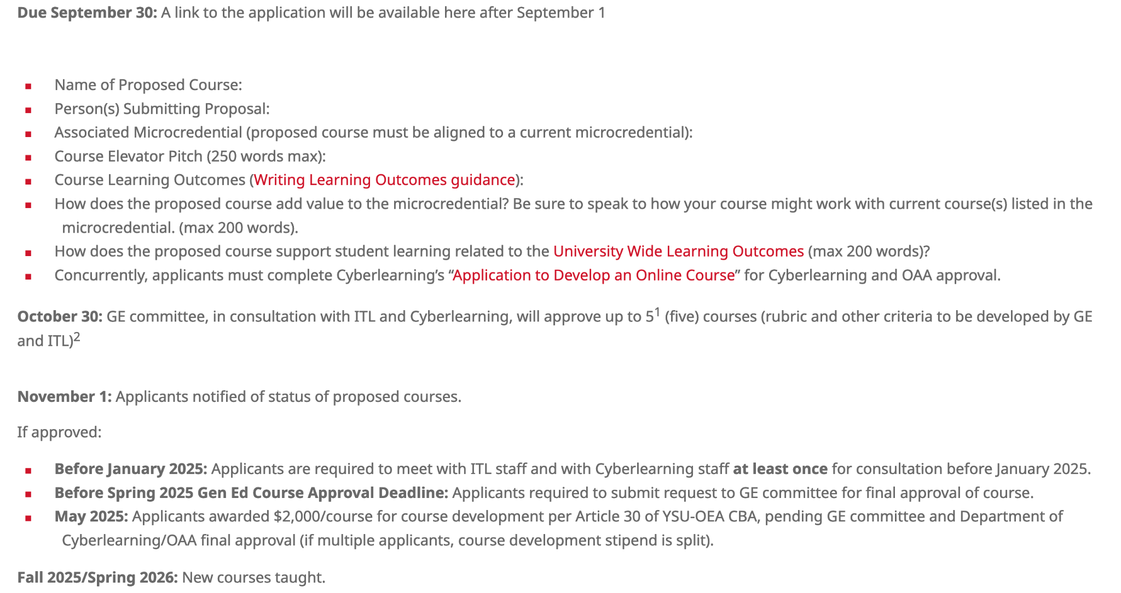
Call for Course Proposals https://ysu.edu/general-education-program/call-for-courses

Slide 17
Assessment
Launch Fall 2024
3 year staggered terms
STEM - year one
A&H/SBS - year two
Comp/Comm - year three
MC assessment
Gen Ed will assess
Data collection in years one and two; assessment in three.
Assessment plan based on:
Cultivating assessment culture
Sharing governance
Ease and purpose (feasibility)
Defining and measuring objectives

Slide 18
Questions

