Slide 1
ACADEMIC MASTER PLAN UPDATE
VISION
The AMP envisions a YSU where:
Students are supported to achieve their full potential.
Academic programs are innovative, market-relevant, and globally competitive.
Faculty and staff thrive in an environment of professional growth and recognition.
Partnerships with the community and industry are strengthened, ensuring our work aligns with regional and global needs.
PURPOSE
The AMP aims to position YSU as a leader in academic innovation and student achievement. It provides a framework for:
Enhancing student outcomes.
Advancing research and scholarship.
Strengthening operational efficiency.
Cultivating an inclusive and collaborative university environment.
PILLARS
Student Success
Program Innovation & Exploration
Community Engagement
One Team, One Mission
TIMELINE

Slide 2
OHIO: THE HIGH SCHOOL COMPETITION FACTOR
 | In-state Counts | Percentage
2023-24 High School Seniors | 132,520
Institutions of Higher Education | 199
College Continuation | 87,478 | 66%
Leave the State to Go to College | 14,203 | 11%
Remain in Ohio for College | 73,275
 | In-state Freshman | Estimated Market Share
Top 5 Institutions for Market Share (2 CC) | 20,108 | 28% | 4-9% range
Remaining Students | Remaining Institutions | Students Per Institution
53,167 | 194 | 274

Slide 3
ENROLLMENT ENTERPRISE CONCEPTUAL FRAMEWORK
Admissions (Processing/ Recruitment)
Outreach Functions
Marketing
Financial Aid
Orientation/First Year
Academic Units
Matriculation Functions
Enrollment Enterprise
Academic & Affinity Functions
Registrar
Student Success
Honors College
Alumni Affairs
Athletics
Key Strategic Partners:
Technology Office
Housing & Dining
Chief Financial Office
Specialized Functions
Int’l Student Services
Veterans Support

Slide 4
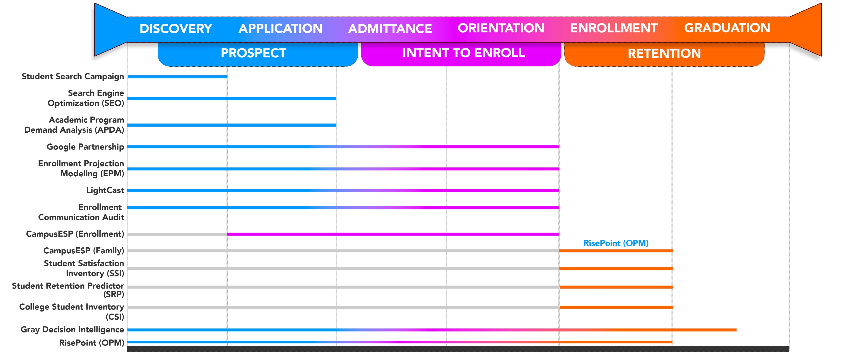
ENROLLMENT ENTERPRISE COMPONENTS

