Slide 1
Interpreting Data from “Student Course Feedback” Surveys (Formerly Student Evaluations of Teaching) Cary Wecht Committee on Teaching and Learning

Slide 2
The Current Survey
Studied by the Senate Teaching and Learning Committee
Solicited feedback from campus community
Goals
Base items on the TEACH framework, Reciprocal Responsibilities doc, and OEA Contract
Focus on concrete behaviors
Avoid global items, items that invite bias, middle scores
Standardize directions, include a statement about bias
Increase response rates
Add items for VAs/TAs, student self-analysis
Focus on survey/item/subscale reliability and validity
Version 1 passed by Academic Senate Feb. 2024, Implemented, Fall 2024
Notes:
Lucy Kerns

Slide 3
Subscales*
Factor 1 – Course Content
Items: 8, 12-20, 23-24, 31-34
16 items (a = .96)
Factor 2 – Feedback and Support Hours
Items: 9-11, 21-22
5 items (a = .80)
Factor 3 – Communication with Teaching Assistant
Items 26-28
3 items (a = .88)
* Factor and reliability analysis of Likert-Type items conducted by Dr. Lucy Kerns, Mathematics and Statistics. The overall Cronbach's alpha was found to be .94, indicating a high level of reliability among all 24 survey questions.

Slide 4
Factor 1 – Course Content
8. The instructor shared how to succeed in the course (e.g., criteria, rubrics, directions, examples).
12. I had a sense of my standing in the course (e.g. grade, instructor feedback) before the last day to withdraw from the course.
13. Content was connected to course goals.
14. Course content was easy to access.
15. The course used a variety of materials to support my learning (e.g., books, multimedia, articles, software).
16. The technology used to deliver this course (e.g., BlackBoard, web-based instructional sites, collaboration systems) provided an effective learning environment.
17. The class provided me with opportunities for problem solving, critical thinking, decision making, or application of material.
18. This class helped me see how to apply course content to practical problems or real-life situations.
19. The course was appropriately challenging for the course level.
20. It was clear how and when to communicate with my instructor.
23. The instructor created an inclusive class environment that communicated value for all individuals.
24. I felt like I could reach out to my instructor.
31. I understood the syllabus.
32. I looked forward to taking this course.
33. I felt prepared to take this course.
34. I attended most class sessions I logged in regularly (online only)

Slide 5
Factor 2 – Feedback and Support Hours
9. The instructor made feedback and/or grades readily available (e.g., in Blackboard).
10. The instructor provided feedback that helped me learn/progress in the course.
11. The instructor indicated when to expect feedback or graded student work.
21. The instructor responded to messages within 48 business hours.
22. The instructor was available during scheduled office/support hours.

Slide 6
Factor 3 – Communication with Teaching Assistant These items will be changed to optional add – F25
26. It was clear how and when to communicate with the online teaching assistant.
27. The online teaching assistant responded to messages within 48 business hours.
28. The online teaching assistant answered my questions in a helpful manner

Slide 7
SB1 required item to be added Summer 25 (not to be included in factor analysis)
“Does the faculty member create a classroom atmosphere free of political, racial, gender, and religious bias?” ___ yes ___ no

Slide 8
Survey data should be one of at least three sources of info about teaching
Should be a departmental decision
Possible sources of info (e.g.,)
Teaching portfolio
Philosophy, course materials, reflections, student response data, class observations, evidence of growth, workshops attended, etc.
Class or video observation of teaching and course materials
See Class Observation document for Department Chairs
Student interviews
Teaching scholarship
Learning outcome measures
Teaching awards

Slide 9
Response Rates
For formative decisions
At least 60% is tolerable with or without additional data
For summative decisions
At least 80% if ratings alone are used
At least 70% if combined with other sources of information such as a teaching portfolio, chair observation, etc.
Because our institutional response rate is lower (around 50%) after moving to online student feedback, academic senate approved the process of returning to the in-class method (where possible) to improve response rates.
Notes:
Ronald Beck (2013). Top 10 Flashpoints in Student Ratings and the Evaluation of Teaching. Stylus.

Slide 10
Interpret with Care
Remember Student Feedback is Not a Measure of Learning
Consider the Context (class rank, difficulty, size, time, required/elective, online or f2f, team taught, innovative teaching strategies, first time teaching, societal issues, minimal or maximal student effort, etc.)
Be open to student comments/suggestions
Can explain high or low ratings
Don’t dwell on negativity (it’s hard, alas!)
Consider thoughtful ideas (look for the helpers!)
Adapt to student voice for continuous improvement
Demonstrate in teaching portfolio

Slide 11
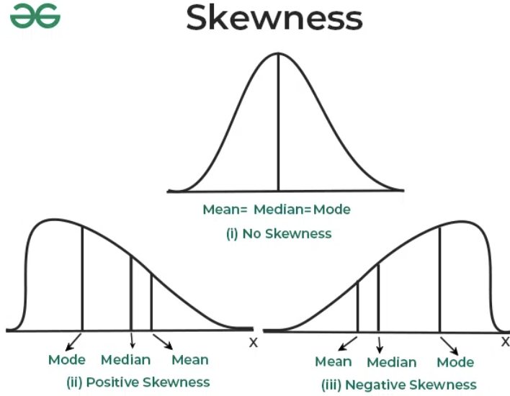
Thinking About the (Likert) Data: Skewness
Most student data are “negatively skewed”
Consider a simple example:
“Course content was easy to access”
(N=16) (SD=1, D=2, A=3, SA=4)
1,1,3,3,3,3,4,4,4,4,4,4,4,4,4,4
Median = 4
Mode = 4
Mean = 54/16 = 3.37
The mean/average is misleading in a negative way; better to report all central tendency data
(could also add standard deviations)

Slide 12
Criterion-Referenced Interpretations
For Formative Decisions (improving teaching, curricula)
Item anchor (SD = 1, D = 2, A = 3, SA = 4)
What percentage of students picked each anchor, item by item?
Consider changes in teaching, evaluation, or behaviors)
Item - Consider benchmarks, 1-4 scale, across classes
Medians at and above 2.0 are strengths, below are weaknesses
For Summative Decisions (pay, promotion), see bigger picture
Need several courses across the year for annual review
Need three or more years for promotion review
Subscale (course content, feedback/support, comm w/asst)
Total scale

Slide 13
One Approach: Midpoint and Upper Limit Standards
 | Extremely Unfavorable | Midpoint | Extremely Favorable
Subscale 1 (16 items) Course Content | 16 | 40 | 64
Subscale 2 (5 items) Feedback, Support Hrs. | 5 | 12.5 | 20
Subscale 3 (3 items) Comm w/TA | 3 | 7.5 | 12
Total Scale (25 items) | 24 | 60 | 96

Slide 14
Another Approach: Third-Quarter Standard
Departments can determine cut-off standards
Avoid arbitrary standards or “gut feelings”
Hold everyone to same standards
In this example, 75% would be a cut-off
Subscale | EU | U | Mdpt | F | EF
Subscale 1 | 16 | 28 | 40 | 52 | 64
Subscale 2 | 5 | 8.75 | 12.5 | 16.25 | 20
Subscale 3 | 3 | 5.25 | 7.5 | 9.75 | 12
Total | 24 | 42 | 60 | 78 | 96
Grade | F | D | C | B | A

Slide 15
Summary
The student survey is a work in progress
Should be one of several sources of information
Response rates are important
Data should be interpreted with care
Mean scores are misleading
Data can be considered at several levels
Anchor
Item
Subscale
Total
Midpoint, third quarter, upper limit standards
Departments should discuss how to use these data

