Slide 1
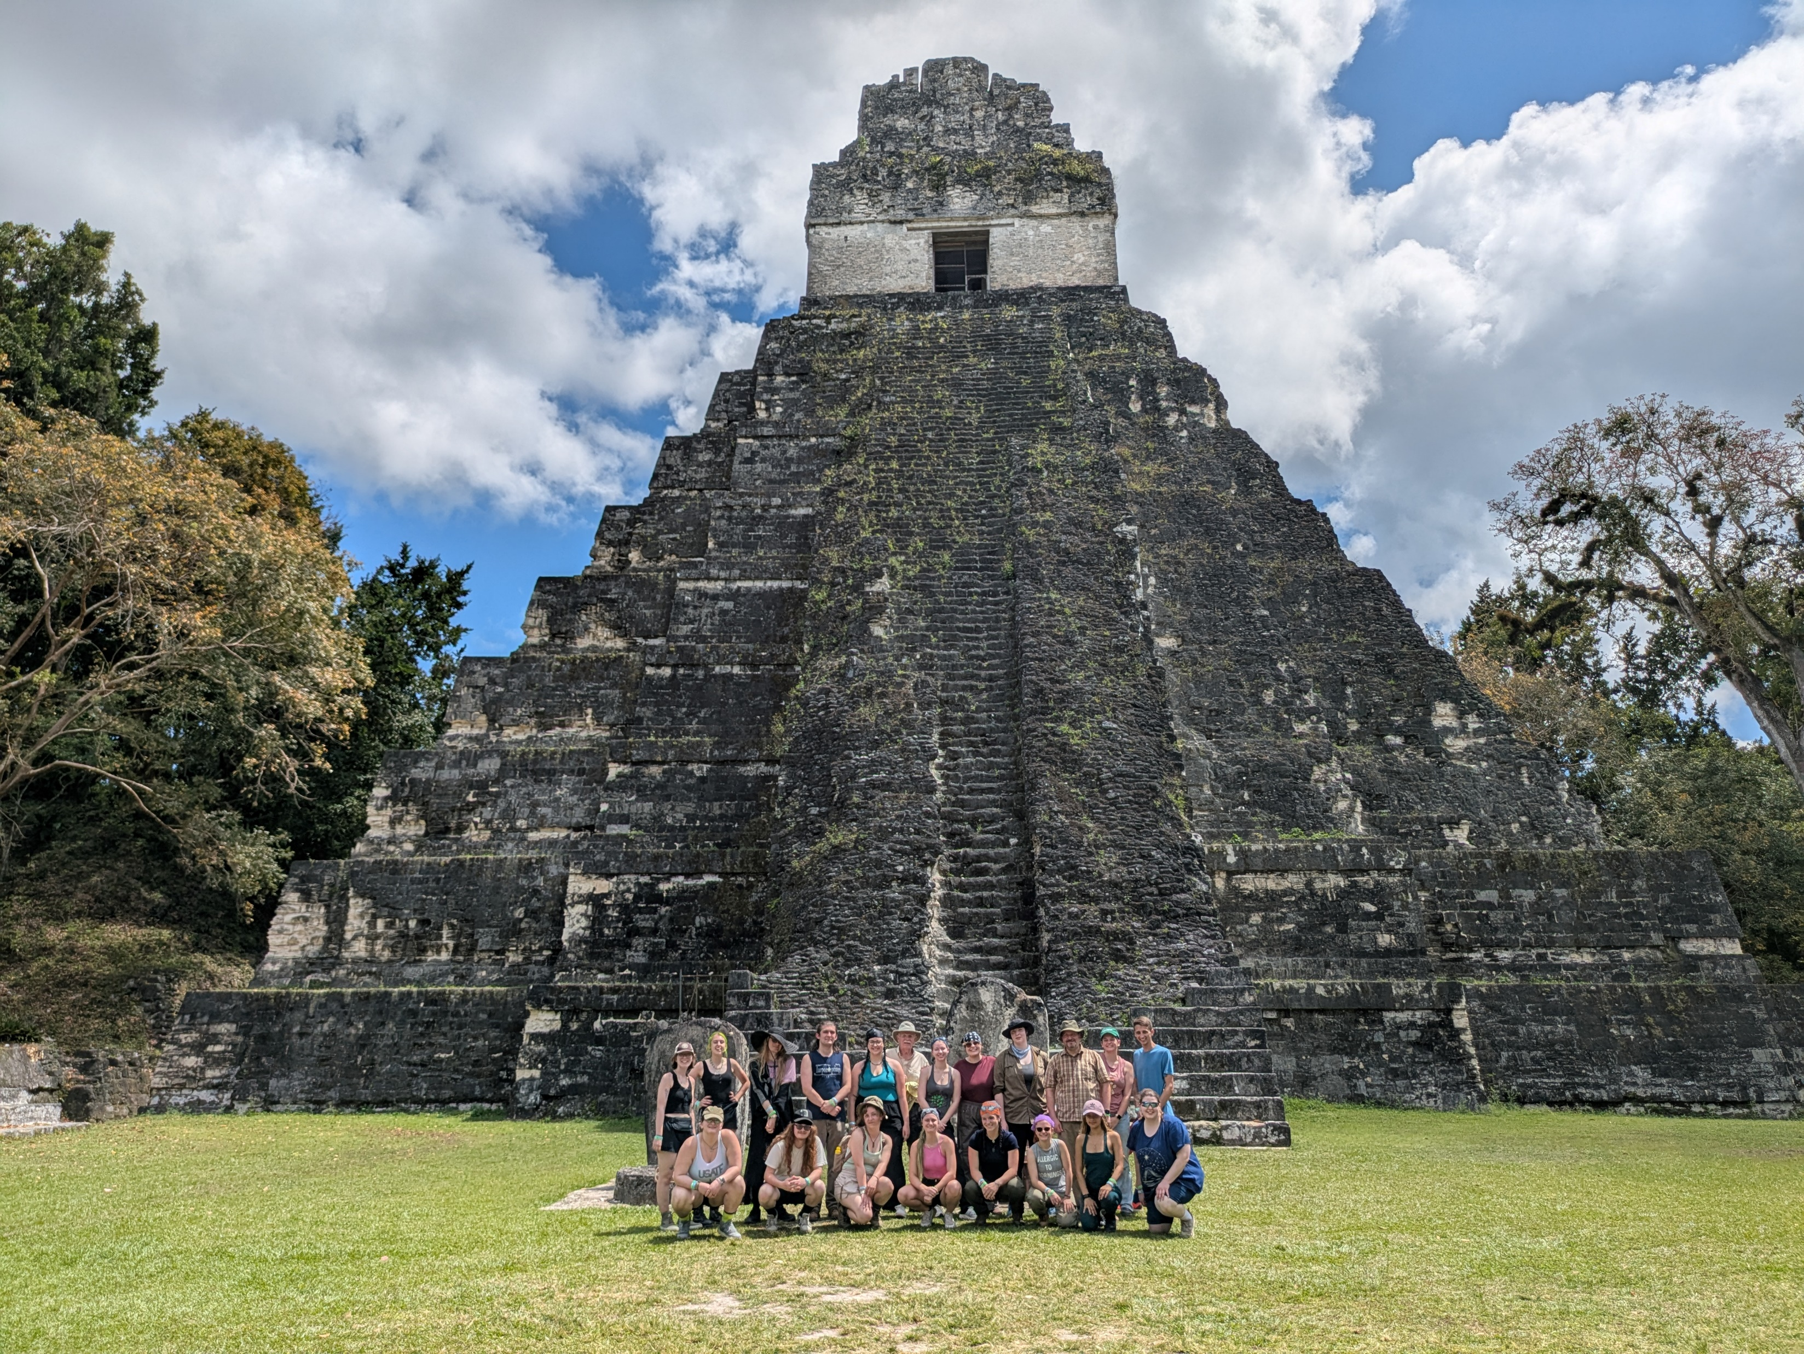
SURVEY ON ACADEMIC INTEGRITY RESULTS
COMPLETED RESPONSES: 120
-77 full-time faculty
-38 part-time faculty
-5 other (2 chairs, 1 admin, 1 part-time student success instructor, 1 “sdfgsdf”)
BY COLLEGE:
BCLASSE: 41
STEM:33
HHS:30
WBCA: 10
CCCA: 5

Slide 2
Aware of policies and procedures on academic integrity?
Yes: 85%
Aware of the academic integrity form?
Yes: 67%
Had an issue with academic integrity in class?
Yes: 53%
Most commonly cited issues:
Plagiarism (from source materials or other students)
Use of generative AI
Various forms of cheating in online classes/assessments
Used academic integrity form?
Yes: 31% (most 1-5 times, several 10+ times)
Most common reason for not using: unaware of form OR handled by self

Slide 3
Rate ease of form
Very easy: 5 (13.9%)
Easy: 21 (58.3%)
Hard: 8 (22.2%)
Very hard: 2 (5.6%)
How to encourage more faculty to use the academic integrity process?
Broad range of replies; among more common replies:
Make the form and process less cumbersome/time consuming
Send reminder email to faculty at start of semester
Current process seems to favor students
Don’t; should be more educational or “friendly” process

