Slide 1
Senate AI Ad Hoc Committee
Committee:
Chairs: Joseph Palardy, Hillary Fuhrman
Members: Jeff Coldren, Bob Gilliland, Dana Sperry, David Frank, Stephanie Smith, Jessica Chill, Rachel Faerber-Ovaska, Richard Rogers

Slide 2
Revolution in American Work: 1910 vs. 2015
A Century of Change
Farming: Workforce share plummets from 31% to under 1%
Manual Labor: Drops sharply from 38% to just 20%.
Professional & Tech: From 5% to become the largest group at 28%
Service Sector: Nearly doubles its from 10% to 17%.
Hands & Fields replaced by Brains & Services.
(Source: BLS Data Comparison, 1910 vs. 2015)

Slide 3
AI & The Next Transformation
1910-2015: Hands & Fields → Brains & Services.
2025-2050: Brains & Services → ?
Questions:
How will work evolve in the age of AI?
How will Higher Education evolve and adapt?

Slide 4
Occupational Heterogeneity in Exposure to Generative AI (Felten et al. 2023)
Highly-educated, highly-paid, white-collar and creative occupations are most exposed to generative AI...

Slide 5
Notes:
The O*NET system is maintained by a regularly updated database of occupational characteristics and worker requirements information across the U.S. economy. It describes occupations in terms of the knowledge, skills, and abilities required as well as how the work is performed in terms of tasks, work activities, and other descriptors.

Slide 6
Rapid Evolution of Generative AI Models
November 2022
ChatGPT 3.5
Context Window ~ 6000 words
Output Length ~ 3000 words
Text Only
Early Undergraduate
March 2025
Gemini 2.5 Pro
Context Window ~750k words
Output ~ 50k words
Text, Audio, Image Generation, Search, Code Execution
Ph.D. Level

Slide 7
Papers I've "directed" since March 25, 2025 (release of Gemini 2.5 Pro)
Optimal Genuine Effort vs. AI Misuse: A Model of Skill Development with Heterogeneous Tasks and Uncertain Futures
Academic Integrity in the Age of AI: A General Equilibrium Model of Student Choice and Institutional Strategy
Asset Pricing and Risk Management under the Skew-t Distribution Assumption: Theory, Empirical Tests, and Applications
DiD-Net: Estimating Conditional Average Treatment Effects in Staggered Difference-in-Differences using Two-Headed Neural Networks (almost done)
Monetary Policy Lock-In: Housing Supply Frictions and Inflation Persistence in a Heterogeneous Agent New Keynesian Model (still need to do some simulations)

Slide 8
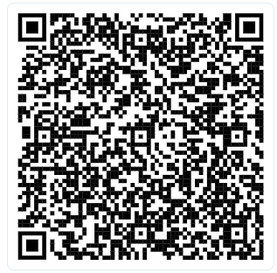

Slide 9
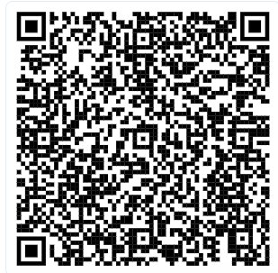
Textbook Chapter
Don't Panic! An Introduction to Personal Financial Planning
Slides
120 Question Blackboard Test Bank

Slide 10
Student Use of AI
Assume students have answers to all problem sets along with detailed explanations.
AI usage by students is a continuum from limited help and use to straight AI writing their papers.
Genuine knowledge and skill is still incredibly important.
Need to find ways to deal with the Generative AI Paradox
“Generative AI makes tasks easier for people while simultaneously deteriorating their abilities to learn the skills required to solve those task?

Slide 11
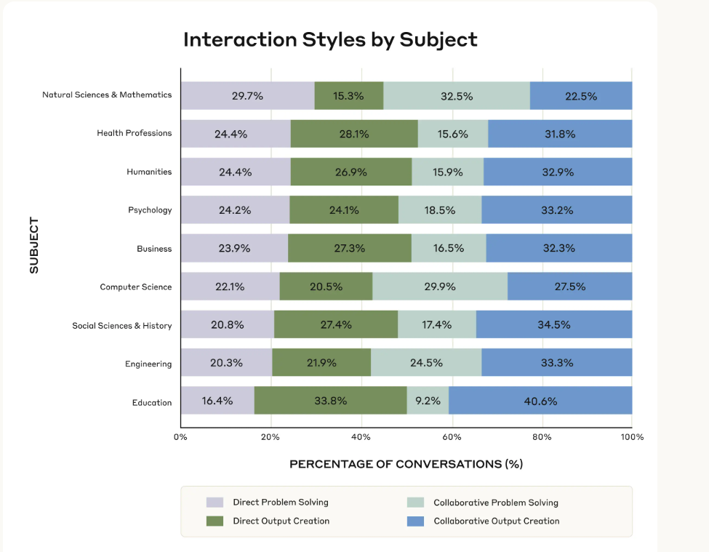
Anthropic Education Report: How University Students Use Claude

Slide 12
AI's Transformative Impact on Production by Skill Level

Slide 13
AI's Uneven Abilities
The "Jagged Frontier"
AI skills vary greatly: Excels at some tasks, fails unexpectedly at others.
Has capability "peaks" (strengths) and "valleys" (weaknesses).
Crucial: Know where AI works well vs. where it doesn't.

Slide 14
Exposure does not mean elimination
AI Changes Work: Augment, Adapt, Evolve
Opportunities for YSU: Help “enrich the region and enhance the future of students by facilitating those evolutions”

Slide 15
What do we do?
Leadership, Coordination, Tracking, and Continual Evaluation
Comprehensive AI Literacy at All Levels
Curricular and Assessment Reforms at the Program and Course Levels
Discussions about Resources and Responsibilities

Slide 16
Leadership, Coordination, Tracking, and Continual Evaluation
Likely need a formal standing committee
Experimentation and evaluation will likely need to happen at the department or unit level

Slide 17
Comprehensive AI Literacy at All Levels
Students, Faculty, and Staff will all need a minimum level of proficiency
Likely need institutional access to frontier models

Slide 18
Curricular and Assessment Reforms at the Program and Course Levels
AI Checkers are a band aid
Easily circumvented
Sometimes violate IT Acceptable Use
Have unintended consequences.
Alternatives
Analyze Field Evolution
Assess Future-Ready Skills
Prioritize Process in Assessment
Validate Genuine Effort
Integrate AI Resistance into Course Design
Proactively Use AI Tools to Devote More Time to High Impact Practices

Slide 19
Discussions about Resources and Responsibilities

Slide 20
Comprehensive Plan Exists, but not ready for circulation
ITL and YSU Online already doing good work
Potential Policy Recommendations
Establish AI Coordination Task Force
Required AI Statement on the Syllabus
Reiterate that open AI tools shouldn’t be used with protected data
Recommend university-wide access to a secure frontier model

Slide 21
Conclusion
Shape Beliefs about the Value of Genuine Effort
Raise the cost of AI misuse
Curriculum and Assessment Design
Address Behavioral Biases
Consider Thresholds and Long-Term Goals
Acknowledge Student and Skill Heterogeneity

