Slide 1
Academic Senate
September 3, 2025

Slide 2
Agenda
State of Ohio Budget Bill
  Academic Senate implications
  Additional step in the current process for program and course approvals
Ohio Revised Code regarding program deactivations
  YSU program deactivations
  Waivers
  APEEI categories for AY 25-26
Controversial topics
  Provost interpretation of expectations

Slide 3
State of Ohio Budget Bill: ORC 3345.457
The board of trustees …. has ultimate authority to establish new academic programs, schools, colleges, institutes, departments, and centers at the institution.
  ….may not delegate the board's authority to adopt a curricular approval process under this section or to approve or reject academic programs.
The board of trustees ….. shall adopt a curricular approval process to establish and modify academic programs, curricula, courses, general education requirements, and degree programs. The process … shall do all of the following:
  Grant the .. senate….the opportunity to provide advice, feedback, and recommendations on the establishment and modification of academic programs, curricula, courses, general education requirements, and degree programs;
  Clarify that all feedback and recommendations….. is advisory in nature;
  Retain the board's final, overriding authority to approve or reject any establishment or modification of academic programs, curricula, courses, general education requirements, and degree programs.

Slide 4
Spreadsheets for Board of Trustees - Courses
Course additions
Course prerequisite changes
Course deletions
2 sentence overview of why this course needs added | How does this course demonstrate intellectual diversity (2 sentences) | What programs will use this course (name and degree level) | How many students can be accomodated in each section offerred | Senate Recommended?
2 sentence overview of why this prerequisite change helps the students | What other programs use this course (name and degree level) | How many students can be accomodated in each section offerred | Senate Recommended?
2 sentence overview of why this course should be deleted | What other programs use this course (name and degree level) | Will this course be replaced with another. If so, what course? | Senate Recommended?

Slide 5
Department recommendation
College recommendation
Academic Senate recommendation
BOT Approval
OAA endorsement
Faculty or OAA proposes course change, add, deletions
Notes:
COURSES

Slide 6
Spreadsheets for Board of Trustees - Programs
2 sentence overview of why this program needs added | What employment opportunities are there with this degree (list) | How does this program demonstrate intellectual diversity (2 sentences) | Senate Recommended?
Courses within the new program:
2 sentence overview of why this course needs added | What programs will use this course (name and degree level) | How many students can be accommodated in each section offered | How does this course demonstrate intellectual diversity (2 sentences)

Slide 7
Faculty or OAA proposes program, minor, or certificate
OAA preliminary recommendation
Department recommendation
College recommendation
Academic Senate recommendation

Slide 8
Faculty or OAA proposes program, minor, or certificate
OAA preliminary review and support
BOT preliminary review
Department recommendation
College recommendation
Academic Senate recommendation
BOT Approval
OAA endorsement
Notes:
New programs, certificates, minors

Slide 9
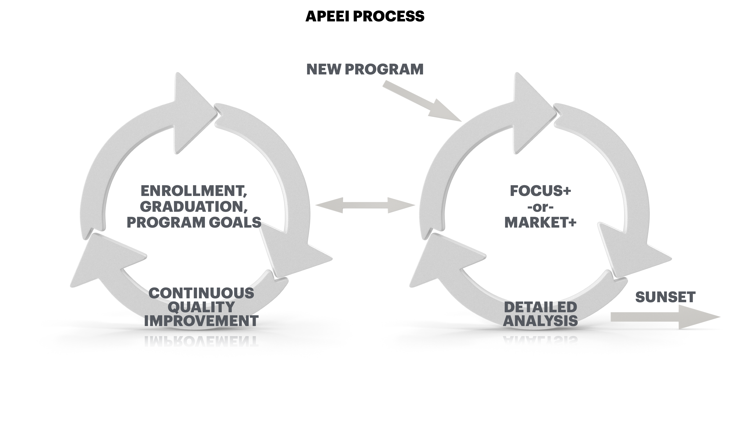

Slide 10
Senate Bill 1 revised code regarding program deactivations
A state institution of higher education shall eliminate any undergraduate degree program it offers if the institution confers an average of fewer than five degrees in that program annually over any three-year period.

Slide 11
Programs averaging fewer than 5 graduates over past 3 years
YSU program deactivations
  BA Chemistry
  BA Physics
  BA Geology
  BS Geology
  BA Theatre Studies
  BA Biology
YSU waivers
  BS Chemistry
  BS Physics
  BS Physics Astronomy
  BFA Audio and Music Production

Slide 12
Senate Bill 1 revised code regarding program deactivations
In 2025, programs subject to elimination must be inactivated within 90 days after the effective date of the law. In subsequent years, by August 15 following the completion of the academic year that triggered the program elimination.
In 2025, a request for a waiver for programs subject to elimination pursuant to ORC Section 3345.454 is due within 60 days after the effective date of the law (August 26, 2025). In subsequent years, a request for a waiver is due by July 15 following the completion of the academic year that triggered the program elimination.

Slide 13
Waiver Form Questions Required by the State
Sections 1-4
Provide the rationale for the request to waive the requirement to eliminate the undergraduate degree program.
Indicate whether the institution consulted with advisory groups, business and industry, or other experts to assess whether to submit a request for an exception to maintain the program. If so, briefly describe the involvement of these groups.
How many students are currently enrolled in the program and what are their anticipated graduation dates? Give anticipated number of graduates by year for the next three years.
Provide a four-year plan for increasing enrollment, retention, and graduation.
Provide evidence of the needs assessment/market analysis, including economic and workforce needs data, that support the continuation of this program. Options and resources to meet this requirement may include, but are not limited to, the following:
  Institutions can find data on Ohio in-demand jobs at: https://topjobs.ohio.gov/top-jobs-list.
  Another site that can provide support for Ohio job needs is: https://ohiolmi.com/Home/Projections/ProjectionsHome.
  The U.S. Department of Labor has data at https://www.bls.gov/emp/. This data might supplement the above links.
Accreditation results (if applicable) from most recent review

Slide 14
SECTION 5: BUDGET, RESOURCES, AND FACILITIES
Prescriptive table provided that must be completed
  Describe the financial plan/budget for the next four years of program operation
  If a net loss over four years is anticipated an additional justification for the program must be provided
  Retention Calculation
Verification and Signature
  Neal McNally, Chief Financial Officer at Youngstown State University, verifies that the information in the fiscal impact statement is truthful and accurate.
  Bill Johnson, President, Youngstown State University verifies that the information in the application is truthful and accurate.

Slide 16
APEEI CATEGORY PLACEMENT FACTORS
While these criteria provide general direction for program placement, they are not definitive. Other considerations within or beyond those listed in this table may warrant placing a program in a different category.
 |  | Category
 |  | Continuous Quality Improvement (CQI) | Detailed Analysis (DA) | Sunset
# Grads (3 yr. avg.) |  | >9 | 5 - 9 | <5* (SB1) not exclusive criteria *Programs may be placed here due to strategic direction, external constraints, or risk factors beyond listed metrics
# Students Enrolled | Associates Bachelors Masters | >10 >50 >18 | <10 <50 <18
Goals, Pitch Statements, Action Steps |  | High Impact / Evolving | Low Impact / Stagnant
Fiscal Sustainability |  | (+) Standing | (-) Indicators

Slide 17
Bachelors: CQI
Bachelor of Arts in Communication
Bachelor of Arts in Multimedia Communication
Bachelor of Arts in Political Science
Bachelor of Arts in Psychology
Bachelor of Engineering in Chemical Engineering
Bachelor of Engineering in Civil Engineering
Bachelor of Engineering in Electrical Engineering
Bachelor of Engineering in Industrial and Systems Engineering
Bachelor of Engineering in Mechanical Engineering
Bachelor of Fine Arts in Graphic Design
Bachelor of Fine Arts in Studio Art
Bachelor of General Studies in General Studies
Bachelor of Music in Music Education
Bachelor of Science in Applied Science in Allied Health
BSAS in Civil and Construction Engineering Technology
Bachelor of Science in Applied Science in Criminal Justice
Bachelor of Science in Applied Science in Exercise Science
Bachelor of Science in Applied Science in Forensic Science
BSAS in Information Technology
Bachelor of Science in Biochemistry
Bachelor of Science in Biological Sciences
BSBA in Accounting
BSBA in Business Administration
BSBA in Finance
BSBA in Human Resource Management
BSBA in Management
BSBA in Marketing
Bachelor of Science in Computer Science
Bachelor of Science in Dental Hygiene
BSE in Adolescent Young Adult Education
BSE in Middle Childhood Education
BSE in Primary/Primary Intervention Specialist
BSE in Special Education
Bachelor of Science in Nursing
Bachelor of Science in Respiratory Care
Bachelor of Social Work

Slide 18
CQI
Masters:
Master of Science in Nursing Adult-Gerontology Acute Care Nurse Practitioner
Master of Science in Education - Teacher Education
Master of Science in Education - Educational Administration
Master of Science in Education in Counseling
Master of Social Work
Master of Computing and Information Systems
Master of Science in Nursing Family Nurse Practitioner
Master of Business Administration
Master of Science in Nursing Nurse Anesthetist
Master of Public Health
Master of Education in Intervention Services
Master of Science in Biological Sciences
Master of Science in Engineering Civil and Environmental Engineering
Master of Respiratory Care
Master of Arts in Professional Communication
Master of Science in Mathematics
Master of Science in Education - Special Education
Master of Science in Criminal Justice

Slide 19
Detailed Analysis: Bachelors
Bachelor of Arts in Anthropology
Bachelor of Arts in English
Bachelor of Arts in History
Bachelor of Arts in Journalism
Bachelor of Arts in Philosophy
Bachelor of Arts in Sociology
Bachelor of Fine Arts in Theatre
Bachelor of Music in Music Performance
Bachelor of Science in Applied Science in Dietetics
BSAS in Electrical Engineering Technology
BS in Applied Science in Public Health
BSBA in Business Analytics and Economics (new)
BS in Environmental Science
BS in Geographic Information Science (new)
BS in Mathematics
BS in Medical Laboratory Science
BSAS in Mechanical Engineering Tech

Slide 20
Detailed Analysis: Masters
MSE in Electrical Engineering
Master of Music Music Education
MSE in Chemical Engineering
MS in Data Science and Statistics
MSE in Engr Elect and Computer
Educational Specialist in School Psychology
MS Business Analytics (new)
MS in Environmental Science
MSE Industrial and Systems Engineering
Master of Music Music Performance
MSE Mechanical Engineering
Master of Athletic Training
MS in Engineering Management
MS in Chemistry
Master of Arts in English
MS in Nursing Nurse Education

Slide 21
Controversial Topics
Statement of Commitment - 3345.0216
Affirmation Statements – 3345.0217
“Other” requirements

Slide 22
Controversial Topics – Statement of Commitment
Sec. 3345.0216. (A) Each state institution of higher education, as defined in section 3345.011 of the Revised Code, shall incorporate all of the following statements into a statement of commitment
The institution declares that it will educate students by means of free, open, and rigorous intellectual inquiry to seek the truth.
The institution declares that its duty is to equip students with the opportunity to develop the intellectual skills they need to reach their own, informed conclusions.
The institution declares its commitment to not requiring, favoring, disfavoring, or prohibiting speech or lawful assembly.
The institution declares it is committed to create a community dedicated to an ethic of civil and free inquiry, which respects the autonomy of each member, supports individual capacities for growth, and tolerates the differences in opinion that naturally occur in a public higher education community.
The institution declares that its duty is to treat all faculty, staff, and students as individuals, to hold them to equal standards, and to provide them equality of opportunity, with regard to those individuals' race, ethnicity, religion, sex, sexual orientation, gender identity, or gender expression.

Slide 23
Affirmation Statements: ORC 3345.0217
primary function is to practice or support the practice, discovery, improvement, transmission and dissemination of knowledge and citizenship education by means of research, teaching, discussion and debate;
……ensure the fullest degree of intellectual diversity;
encourage students to reach their own conclusions about all controversial beliefs or policies and shall not seek to indoctrinate any social, political or religious point of view;
Demonstrates intellectual diversity for course approval, approval of courses to satisfy general education requirements, student courses evaluations, common reading programs, annual reviews, strategic goals for each department and student learning outcomes;
Paragraphs (D)(1)-(4) above do not apply to the exercise of professional judgment about how to accomplish intellectual diversity within an academic discipline, unless that exercise is misused to constrict intellectual diversity.

Slide 24
Affirmation Statements : ORC 3345.0217
Will not endorse or oppose, as a university, any controversial belief or policy, except on matters that directly impact the university’s funding or mission of discovery, improvement and dissemination of knowledge.
University will not encourage, discourage, require or forbid students, faculty or administrators to endorse, assent to or publicly express a given ideology, political stance or view of a social policy nor will Youngstown State University require students to do any of those things to obtain an undergraduate or post-graduate degree.
Paragraphs (D)(5) and (6) do not apply to the exercise of professional judgment about whether to endorse the consensus or foundational beliefs of an academic discipline, unless that exercise is misused to take an action prohibited in (D)(5).

Slide 25
Prohibits political and ideological litmus tests in all hiring, promotion and admissions decisions, including diversity statement and any other requirement that applicants describe their commitment to any ideology, principle, concept or formulation that requires commitment to any controversial belief or policy;
no hiring, promotion or admissions process or decision shall encourage, discourage, require or forbid students, faculty or administrators to endorse, assent to or publicly express a given ideology or political stance;
University will not a use a diversity statement or any other assessment of an applicant’s political or ideological views in hiring, promotions or admissions process or decision;
no process or decision regulating conditions of work or study, such as committee assignments, course scheduling or workload adjustment policies, shall encourage, discourage, require or forbid students, faculty or administrators to endorse, assent to or publicly express a given ideology or political stance;
will seek out invited speakers who have diverse ideological or political views;
Will post prominently on its web site a complete list of all speaker fees, honoraria and other emoluments in excess of five hundred dollars for events that are sponsored by Youngstown State University.

Slide 26
Category | Expected | Inappropriate
Controversial Topics (Political, Racial, Gender, Religious) | Instructor consistently fosters a respectful environment where all identities and viewpoints are welcome. Materials and discussions are handled with neutrality. | Instructor includes explicit bias or preferential treatment based on political, racial, gender, or religious factors. Student viewpoints are suppressed or ridiculed.
Encouragement of Diverse Viewpoints Reflective of Intellectual Diversity | Faculty explicitly invites multiple viewpoints and encourages critical thinking on sensitive topics. Students report that faculty member fosters an environment that made students comfortable sharing diverse opinions. | Faculty member dismisses, discourages, or penalizes students for expressing differing or unpopular views. Only one acceptable view is modeled or rewarded.
Indoctrination vs. Academic Inquiry | Faculty member presents all controversial content from a scholarly lens, presenting opposing views with balance. No language of ideological obligation. | Faculty member pressures students to adopt, express, or support specific social, political, or religious views—verbally or through assignments/grades.
Course Content | Content is used appropriately in academic context (e.g., analyzing systems, social movements, health disparities), and presented with open inquiry. | Content is used in a prescriptive or moralizing way—requiring students to agree with specific definitions or ideologies as part of success in the course.
Student Complaint Response Threshold | Student complaint reflects misunderstanding, disagreement with content, or discomfort with ideas—but no evidence of coercion or bias. May be resolved through informal discussion. | Complaint includes evidence of indoctrination, bias, required ideological expression, or classroom exclusion based on identity or beliefs. Formal review required.
Faculty Evaluation Compliance (Based on required questions) | Students consistently report a classroom atmosphere free of bias and affirm that they are encouraged to discuss varying opinions. | Students report a biased environment and suppression of opposing viewpoints. Evaluation indicates recurring concerns with expressions of intellectual diversity.

Slide 27
Questions?

