Slide 1
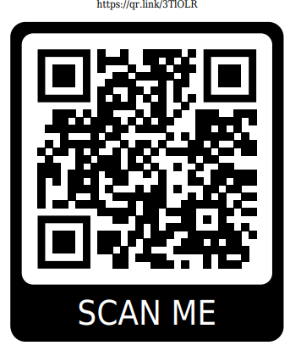
YSU SGA Swipe Out Hunger Donation
Baskets/Prizes to win:
-Roku TV
-Apple Watch
-Fall Basket
-$50 Jimmy Johns Gift Card
-$40 Bull and Bear Gift Card
-$25 MVR Gift Card
-Raising Canes Basket
-Shopping Spree!
-YSU Merch Basket
-Stonefruit Basket
-Dunkin Donuts Basket
-Handels Basket
-JBL Speaker
-Starbucks Basket
All money raised goes directly toward the Penguin Pantry!
Please contact me simyers@student.ysu.edu if you want to buy tickets or come see me after the meeting!
Please consider attending the Desserts with Deans event on Friday 4-6PM in Williamson Hall Atrium, we will be pulling winners and counting donations there!
-$1 for 1 ticket
-$5 for 6 tickets
-$10 for 13 tickets

