Slide 1




YSU GENERAL EDUCATION
Fall 2026 Update
Presented By:
Jackie Mercer

Slide 2




WHERE WE’VE BEEN
Developed an assessment plan
Cleaned up the catalog
Developed and launched a new General Education website

Slide 3


NEW WEBSITE
www.ysu.edu/general-education-program

Slide 4
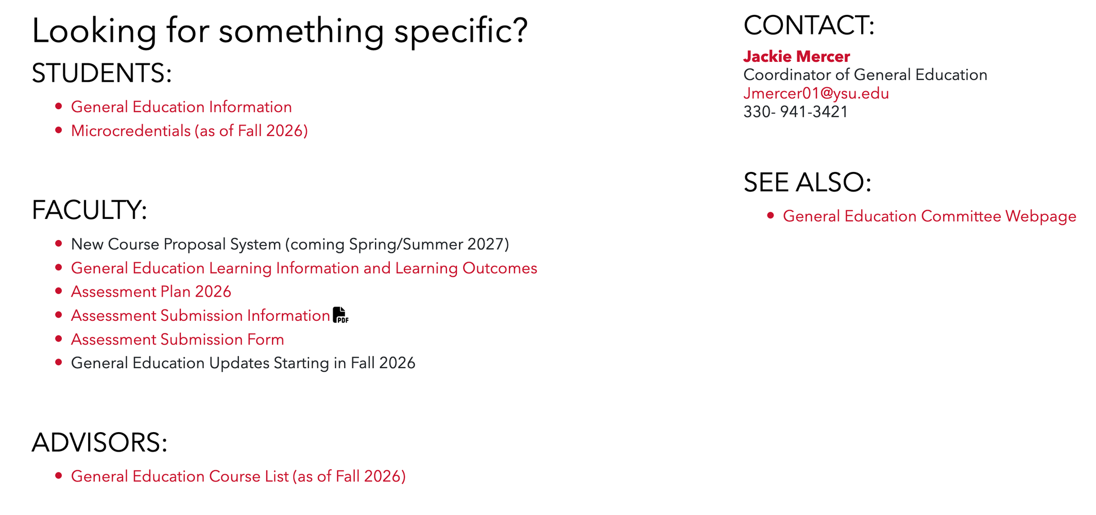


Slide 5










WHERE WE’RE HEADED
HB 96
Protocol for changing courses in the mdoel
Philosophy of General Education
Assessment pilot

Slide 6



HB 96
Not later than December 31, 2026, the board of trustees of each state institution of higher education, as defined in section 3345.011 of the Revised Code, shall formally review and evaluate the components of the state institution's general education curriculum and adopt a resolution acknowledging the board's completion of that review. Each board shall submit a copy of its resolution to the Chancellor of Higher Education.

Slide 7
HB 96
Not later than March 31, 2027, the board of trustees of each state institution of higher education shall formally evaluate the state institution's general education curriculum to enhance content that furthers the state's post-secondary education attainment and workforce goals. In conducting the evaluation, the board shall consider adjusting the general education curriculum in the following areas:

Slide 8
HB 96
(1) Civics, culture, and society, including United States and Ohio history, the foundations of American representative government, how to disagree in a civil manner, and the principles of civil discourse;
(2) Artificial intelligence, STEM, and computational thinking;
(3) Entrepreneurship and the principles of innovation;
(4) Workforce readiness, including fundamental skills necessary for Ohio's graduates to gain employment in in-demand occupations.

Slide 9
HB 96
Not later than June 30, 2027, the board of trustees of each state institution of higher education shall adopt a resolution summarizing changes to the state institution's general education curriculum resulting from the evaluation process and submit a copy of the resolution to the Chancellor.

Slide 10








PHILOSOPHY OF GENERAL EDUCATION
COURSE EVALUATION PROCESS

Slide 11





ASSESSMENT PILOT
  We are planning to assess five courses in each knowledge domain.
  Contact your department chair or Jackie Mercer, jmercer01@ysu.edu, if you’d like your course to be included.
  Assessment will take place in the spring 2027 semester with a chance for faculty and chairs to provide feedback on the process.
  See the General Education website for details.

Slide 12



MICROCREDENTIALS
  The microcredential subcommittee will begin looking at microcredentials this fall.
  Associate Provost Kristine Still will send a communication out to students and faculty reminding them of the process.
  The subcommittee will begin to identify courses for the next set of microcredentials.

Slide 13
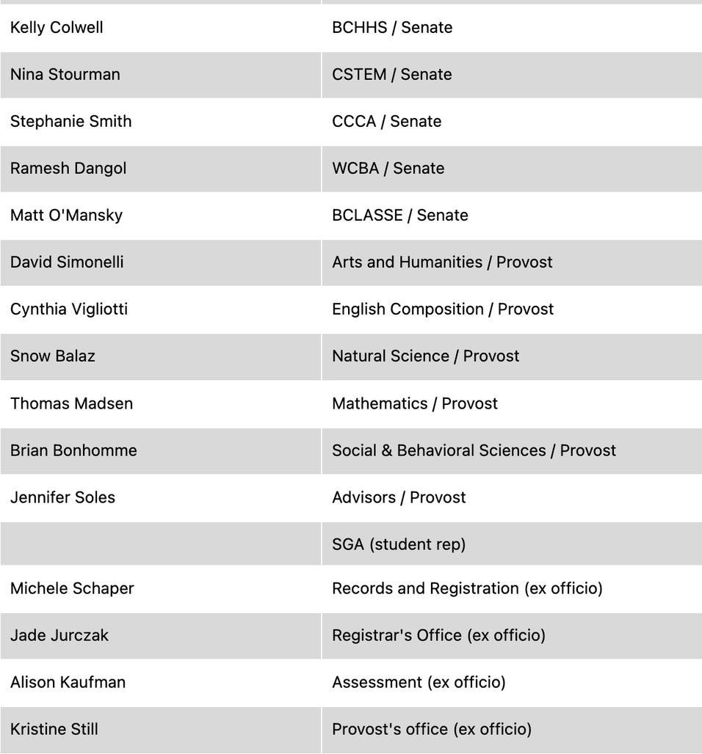
COMMITTEE MEMBERS 2026-2027

